Slide 1

Customer Retention
E-retail factors for customer activation and retention:
A case study from Indian e-commerce customers

Slide 2
Problem Statement:
Customer satisfaction has emerged as one of the most important factors that guarantee the success of online store; it has been posited as a key stimulant of purchase, repurchase intentions and customer loyalty. A comprehensive review of the literature, theories and models have been carried out to propose the models for customer activation and customer retention.
Five major factors that contributed to the success of an e-commerce store have been identified as: service quality, system quality, information quality, trust and net benefit. The research furthermore investigated the factors that influence the online customers repeat purchase intention. The combination of both utilitarian value and hedonistic values are needed to affect the repeat purchase intention (loyalty) positively.

Slide 3

Interpretation of Problem Statement
The data is collected from the Indian online shoppers. Results indicate the e-retail success factors, which are very much critical for customer satisfaction.
The aim of the case study is to analyze the collected data, to give findings and conclusions which would enable the e-tailers to identify the challenges and ways to improve the quality of online stores and enhance repeat purchase intention ( loyalty) of customers.

Slide 4
EDA Steps
Loading the dataset
Analyzing the shape(rows and columns) and type of data.
Checking for missing values in dataset.
Data Visualization.
Statistical Summary of data (Describe of data.)
Correlation of variables in data.
Findings and Conclusion.

Slide 5
Loading the data.
There are two sheets (one is detailed) and second is encoded in the excel file.
ds = Detailed Dataset
dse = Encoded dataset

Slide 6
Analyzing the shape and type of data.
Shape of data
We have 269 rows and 71 columns in the dataset.
Type of data.
All the columns except column 'Pin Code' is having object type of data. These are categorical in nature. The column 'Pin Code' is having integer type of data.

Slide 7
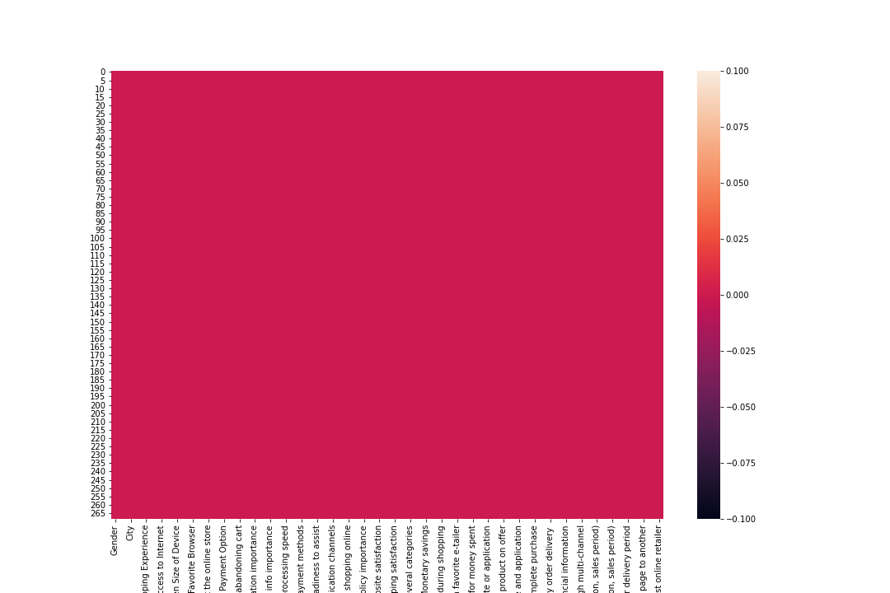
Checking for missing values.
There are no missing values in the dataset.

Slide 8
Data Visualization
We have created a user defined function ‘plot’ that can plot count of values in each columns, countplot and a pie chart. Since the data is categorical in nature(except Pin Code), we have used countplot. Pie chart will help us to understand the proportion of values compared to the total population in percent(%).

Slide 9
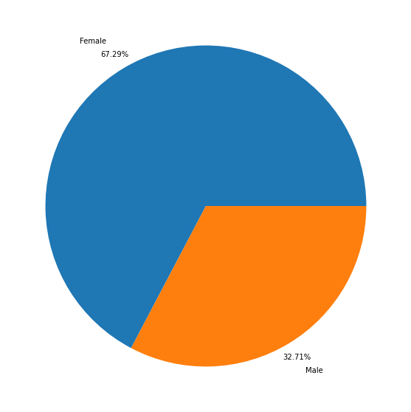
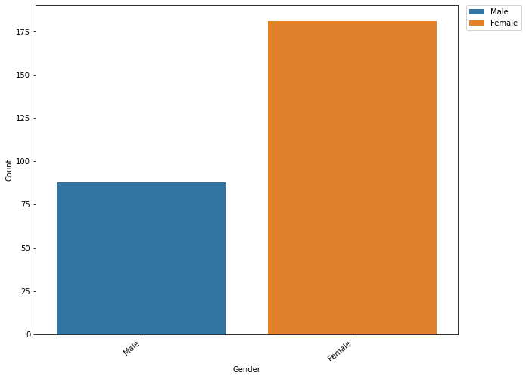
Analysis of data based on Gender
Findings:
1. In the given survey dataset, out of 269 observations 181 were from females and 88 from males.
2. 67.29% population of the dataset are female customers and remaining 32.71% are male customers.
3. As per the given dataset, female customers are shopping more on E-Commerce platforms. Since they consists the majority of the market, it is better to give much more importance on products and services which are useful for female customers. Retaining this female customers is a priority for every e-commerce retailers.
4. Even though the market consists more female customers, 32.71% of male customers are shopping from online retailers. So E-Commerce retailers can concentrate on products and services which are convenient for male customers to bring more customers from offline to online market.

Slide 10
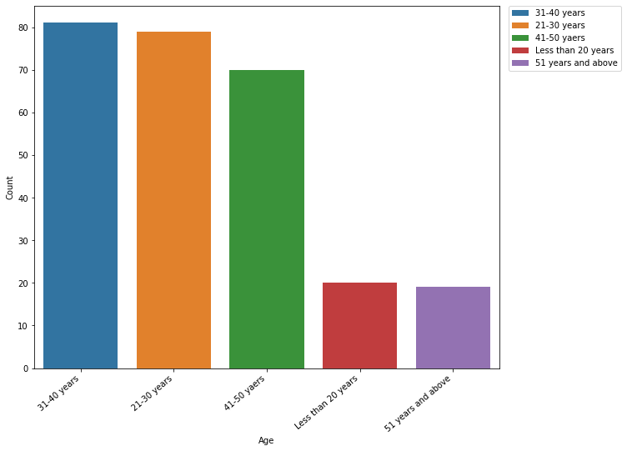
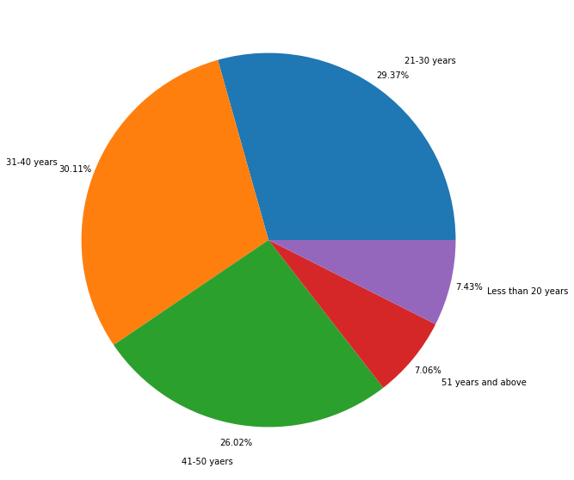
Analysis of data on the basis of Age
Findings:
1. Customers belonging to the age between 31-40 years are having highest shopping from e-commerce platforms with 30.11% of the market. Customers belonging to the age between 21-30 years and 41-50 years are the next major shoppers from e-retailers with 29.37% and 26.02%. Customers who are below the age of 20 years and above the age of 51 years are the ones who least shop from the e-commerce platforms.
2. 85.51% of the customers are between the age of 21-50 years. So, the e-retailers should always give prioritize the needs of customers belonging to this age category. This will help in retaining the repeat purchase customers as these are the customers having the necessity and the financial ability to make the purchases.
3. Even though the customers belonging to the age below 20 years are less, e-retailers should concentrate on them as they are the future customers. Also, the customers above the age of 51 years are focused more on utilitarian value. So, providing quality product and convenient services to this age category customers will help to build loyal customers as they will not look for other options.

Slide 11
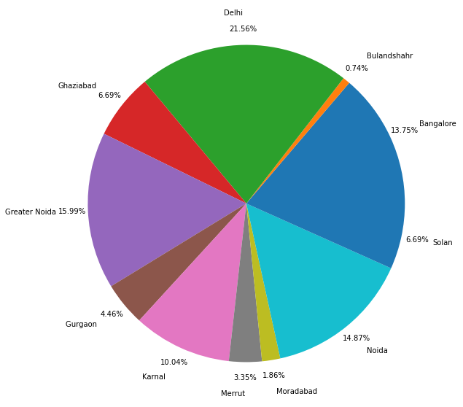
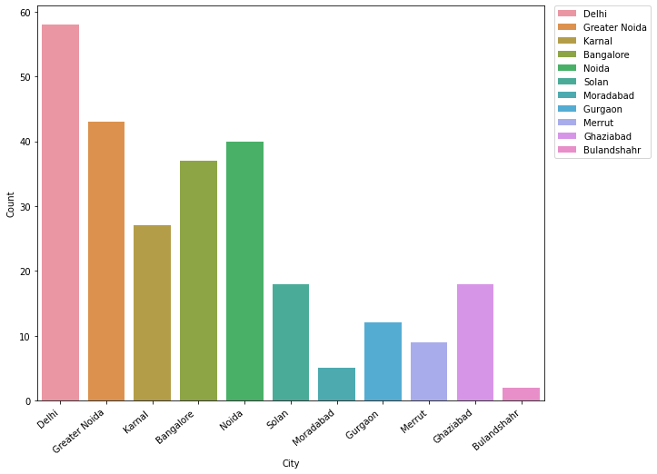
Analysis based on City
Findings:
1. Based on the city, most of the customers are from Delhi, Greater Noida, Noida and Bangalore with 66.17% of the whole population. Rest of the cities are belonging to the 33.83% of the population. There are moderate customers from Karnal, Ghaziabad and Solan. Customers from Gurgaon, Merrut, Moradabad and Bulandshahr are the least online shoppers.
2. Majority of the users are from the metro cities and urban areas. Customers from these cities are proficient with technology and ecommerce compared to the customers from rural area. Also, they have the smart devices, internet connection and other amenities for ease access to the online e-retailers. This is a competitive market segment as most of the e-retailers will try to capture this market to maintain a stability in the number of repeat purchase customers.
3. E-retailers can focus on the customers from the city having least numbers to gain new customers as the technology is advancing, these cities are having potential future customers. Availability of products and services to these cities will gain the helps to capture the market.

Slide 12
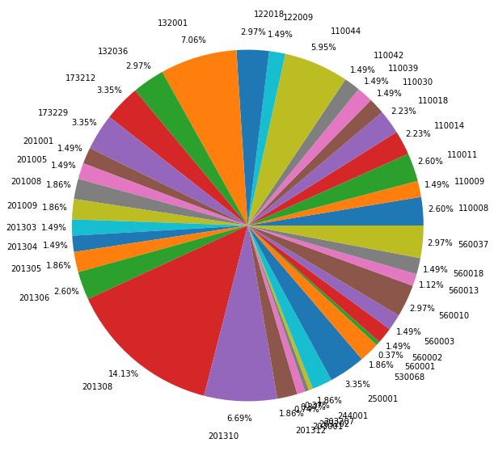
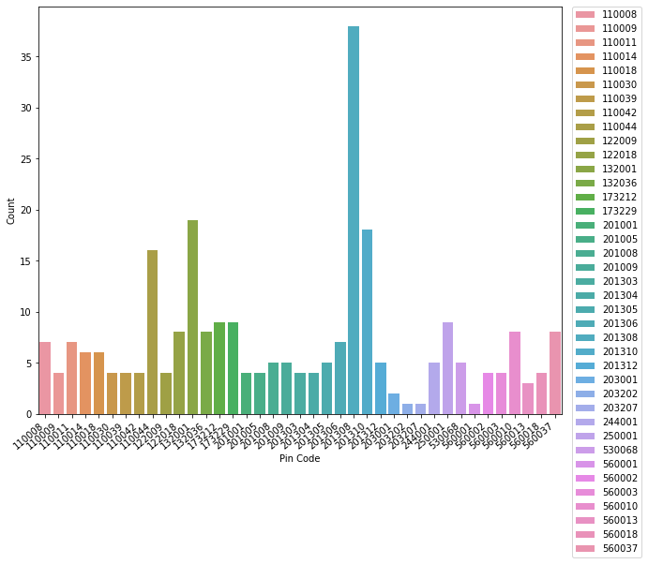
Analysis based on Pin Code
Findings:
1. The top four pin codes having the highest number of customers are from Greater Noida(201308), Karnal(132001), Noida(201310) and Delhi(110044). This will help the e-retailers to study about the segmentation of customers based on where exactly they are located. This will help to provide more products and services based on the specific location after identifying their needs and wants.

Slide 13
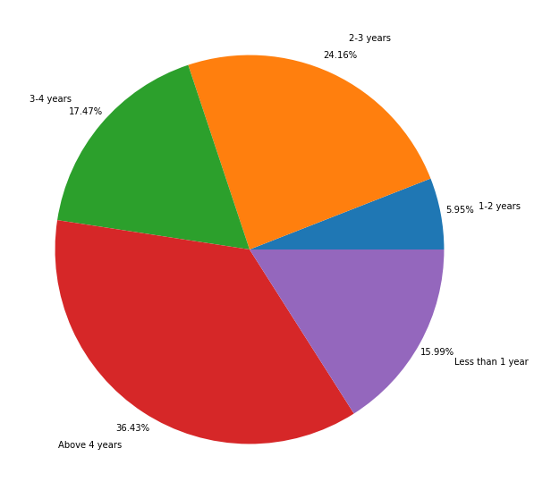
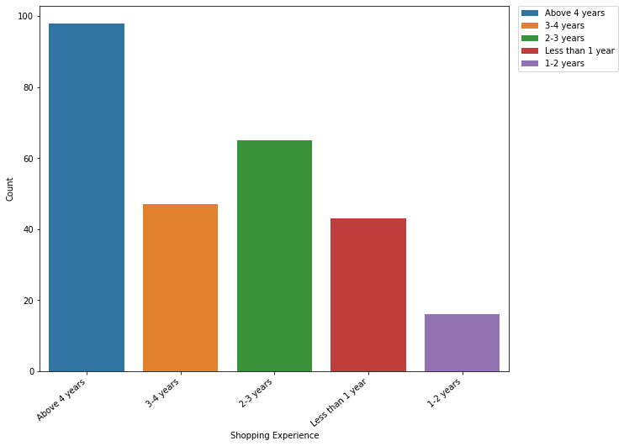
Analysis of data based on Shopping Experience
Findings:
1. 36.43% of the customers are having more than 4-year experience in online shopping. Customers having 3-4 years and 2-3 years experience in shopping, consists of 17.47% and 24.16% of the market, respectively. Only 5.95% of the population are having a shopping experience of 1-2 years. 15.99% of customers are having less than 1 year experience in online shopping.
2. This shows that most of the customers who have participated in the survey have more than 2 years experience in online shopping. So 78.06% of the market are having good knowledge about the online shopping platforms and they have provided their feedback according to their years of experience in this sector. This is one of the good sign that stats majority of the data collected are from customers who are having good experience and knowledge in the e-commerce sector according to their shopping experience.

Slide 14
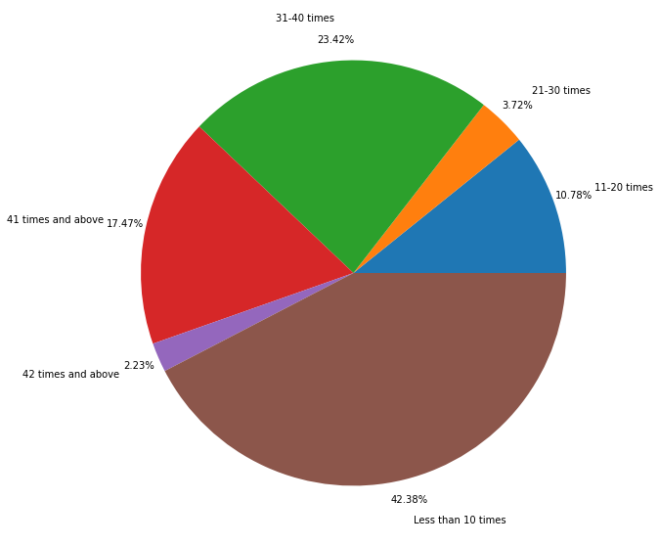
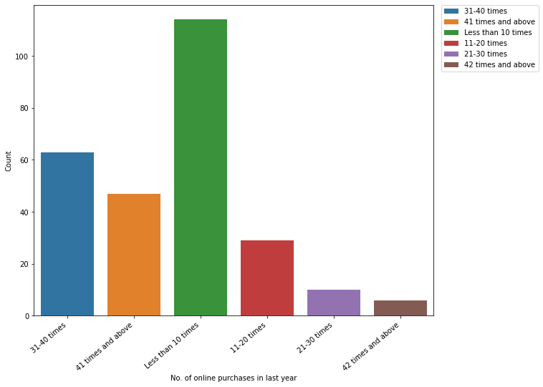
Analysis of data based on no. of online purchases in last year
Findings:
1. Around 42.38% of the customers made less than 10 purchases in the previous year. 23.42% customers have made purchases between 31 to 40 times, 17.47% of customers have made more than 41 purchases and 10.78% of customers have made 11 to 20 purchases in last year.
2. Only a few number of customers have made purchases above 42 times in last year with 2.23% of market and with 21 to 30 purchases in last year with 3.72% of the population.

Slide 15
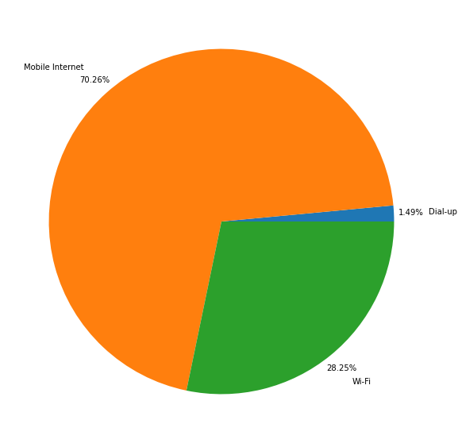
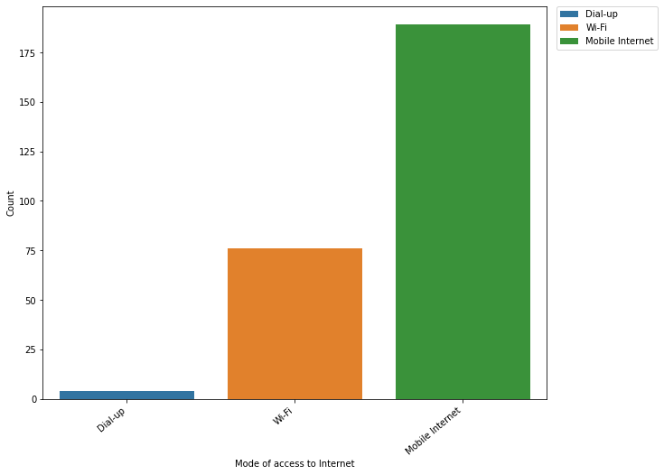
Analysis of data based on mode of access to Internet
Findings:
1. Most of the customers are having mobile as an access to internet. - 70.26%.
2. The number of customers having Wi-Fi as an access to internet is 76 which is 28.25% of the market. The number of customers using Dial-up is 4 which consists only 1.49% of the whole customers.

Slide 16
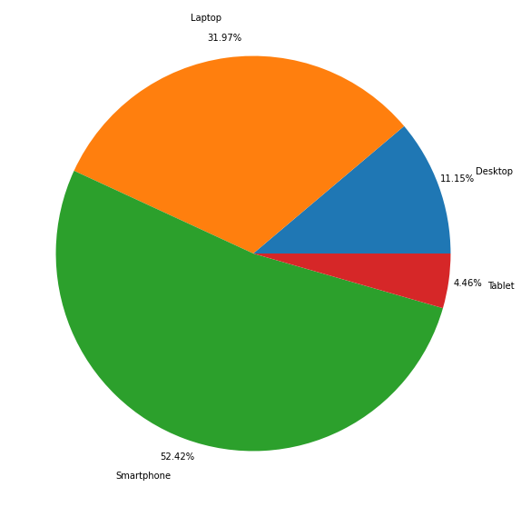
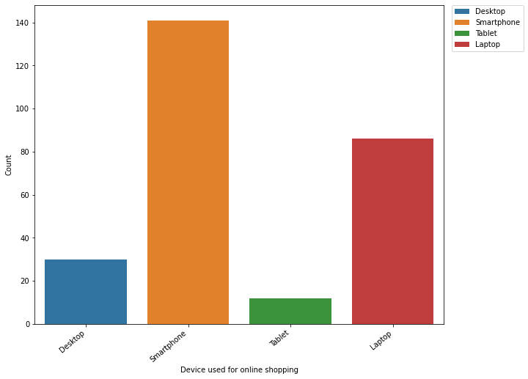
Analysis of data based on device used for online shopping
Findings:
1. The number of customers who are shopping online using smartphone is 141 which is 52.42% of the total customers. Least number of customers have used Tablet to shop online(12) which is 4.46% of the market.
2. The number of customers who are shopping online using laptop is 86 which consists of 31.97% of the total customers and the number of customers who are using desktop for online shopping is 30 which consists of 11.15% of the market.

Slide 17
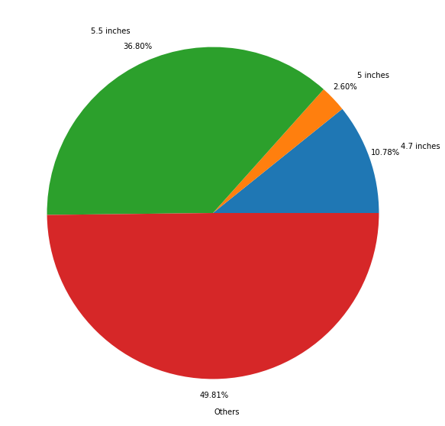
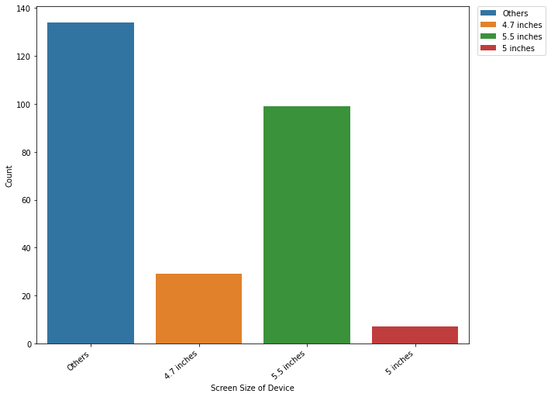
Analysis of data based on screen size of device
Findings:
1. 36.80% of the customers are having smartphone with 5.5 inches screen size. The bigger the screen size, the better they will be able to see the products clearly on online platforms. 10.78% of the customers are having smartphones with a screen size of 4.7 inches.
2. Only 2.60% of the customers are having 5 inch screen size for their smartphone.

Slide 18
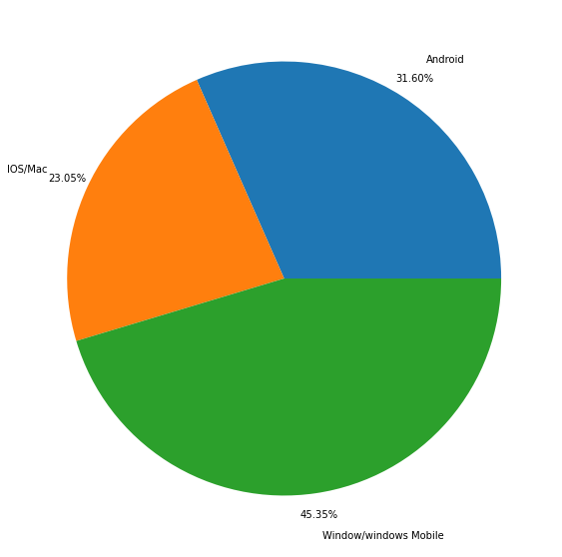
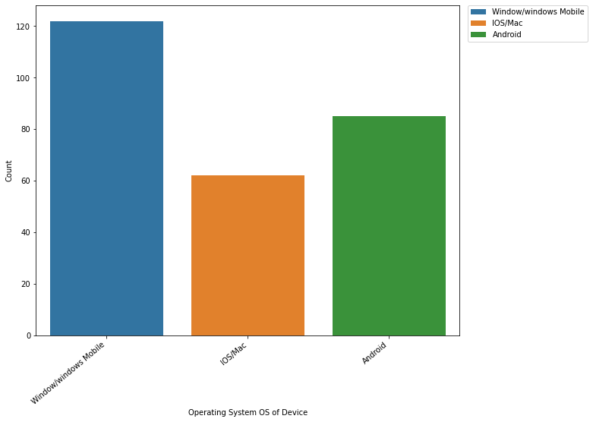
Analysis of data based on operating system of device
Findings:
1. Most of the customers are using Windows operating system(122) with 45.35% of the total customers. The least number of customers are using Mac/iOS operating system(62) consisting 23.05% of the total customers.
2. The number of customers using Android operating system is 85 which consists of 31.60% of total customers.

Slide 19
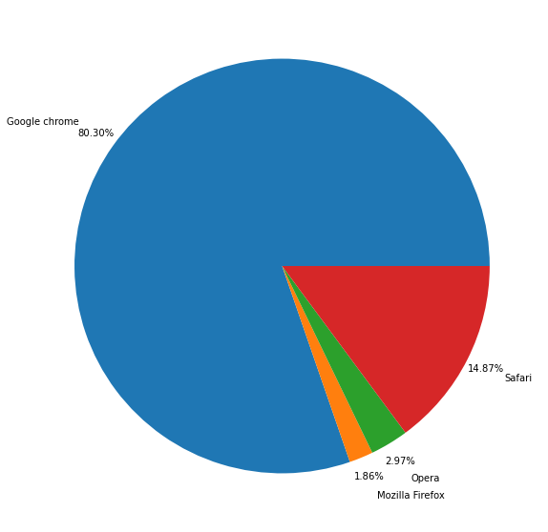
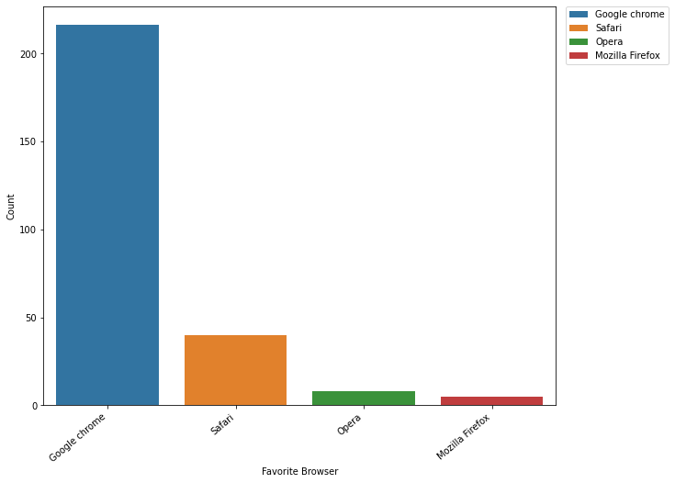
Analysis of data based on favorite browser
Findings:
1. Most number of customers prefer Google Chrome as preferred browser for online shopping(216) which occupies 80.30% of the total customers. The least preferred browser for online shopping by customers is Mozilla Firefox(5) which consists of 1.86% of the total customers.
2. The number of customers using Safari as browser to shop online is 40 which consists of 14.87% of the total customers and the number of customers using Opera as browser to shop online is 8 which consists of 2.97% of the total customers.

Slide 20
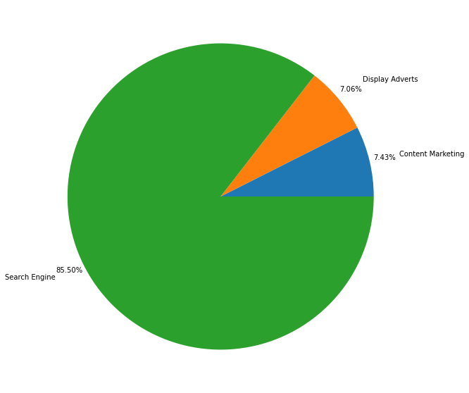
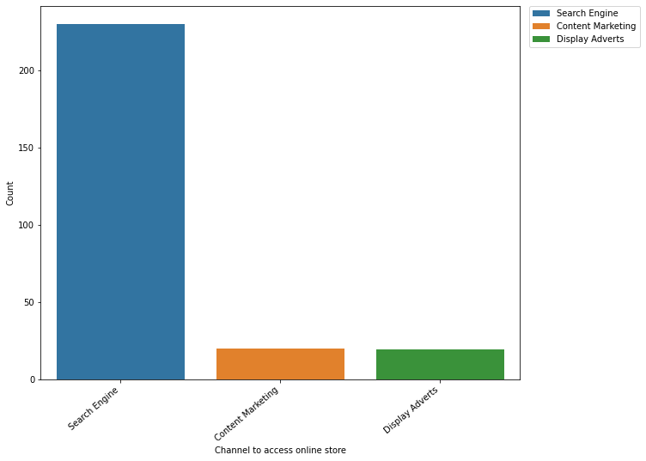
Analysis of data based on channel to access online store
Findings:
1. Most of the customers are preferring Search Engines to access onlines stores(230) which occupies 85.50% of the total customers. Least number of customers are accessing online stores using display adverts(19) which consists of 7.06% of the total customers.
2. The number of customers accessing online stores using content marketing is 20 which consists of 7.43% of the total customers.

Slide 21
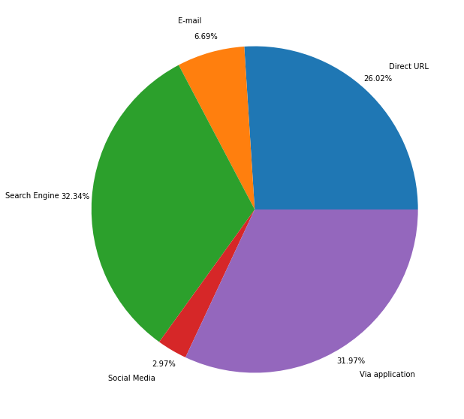
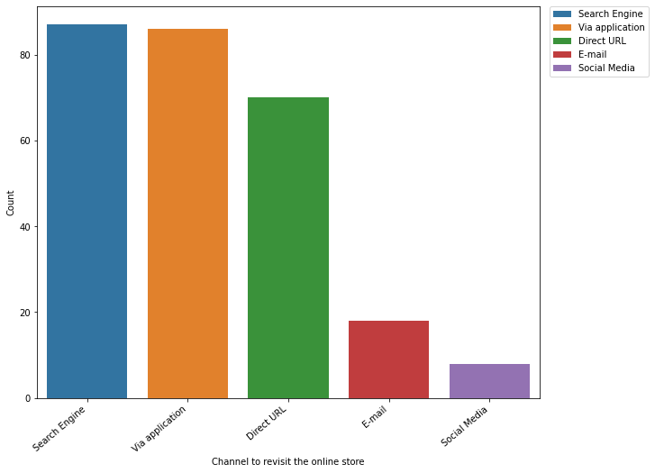
Analysis of data based on channel to revisit the online store
Findings:
1. Most of the customers use search engines to revisit the online store(87).Second most number of customers use application to revisit the online store(86). The number of customers using direct URL for revisiting the online store is 70.
2. Least number of customers are using social media as a channel to revisit the online store which is only 8 customers. The number of customers revisiting online store using email is 18.

Slide 22
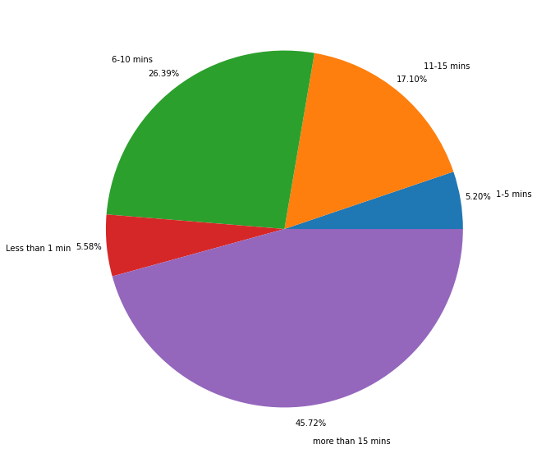
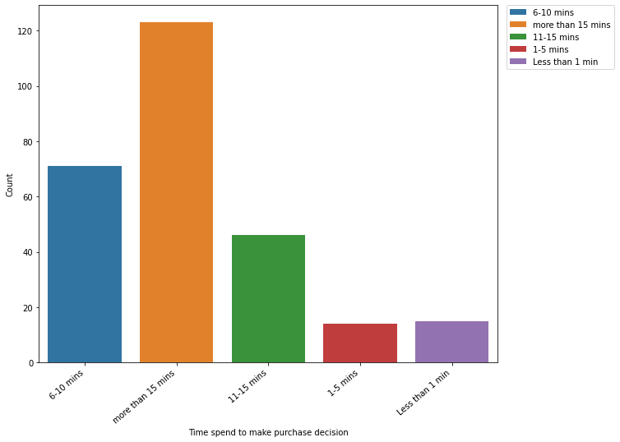
Analysis of data based on time spend to make purchase decision
Findings:
1. The number of customers taking more than 15 minutes to make the purchase decision is higher among the category which is 123 customers and consists of 45.72% of the total customers. The number of customers taking time between 6 to 10 minutes is 71 which consists of 26.39% of total customers. The number of customers taking 11 to 15 mins to make purchase decision is 46 which occupies 17.10% of the total customers.
2. The least number of customers takes 1 to 5 minutes to make purchase decision(14). The number of customers taking less than 1 minute to make purchase decision is 15.

Slide 23
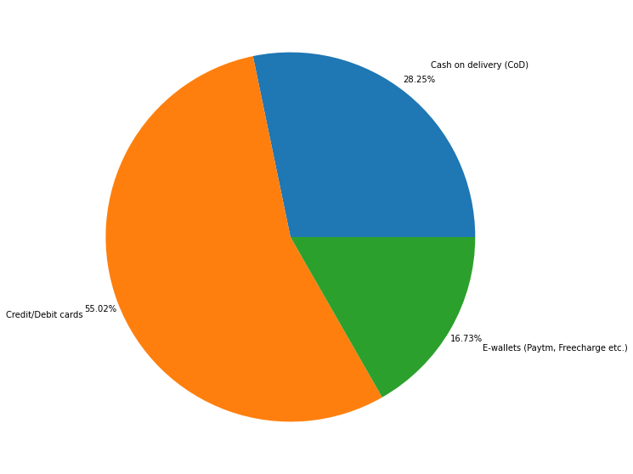
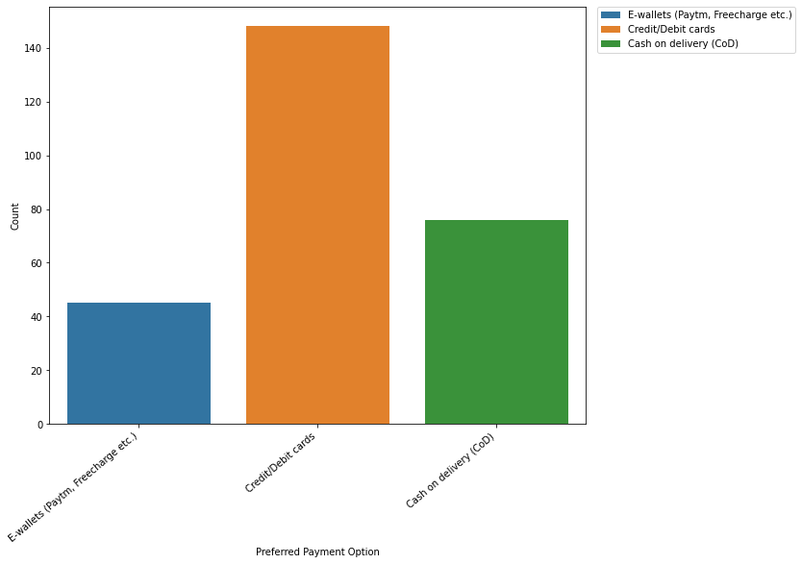
Analysis of data based on preferred payment option
Findings:
1. Most of the customers prefer credit/debit card as payment method for their online shopping(148) which consists of 55.02% of the total customers.
2. The least number of customers prefer E-wallets (Paytm, Freecharge etc.) as payment method which is only 45 customers. The number of customers preferring Cash on Delivery(CoD) is 76 which consists 28.25% of total customers.

Slide 24
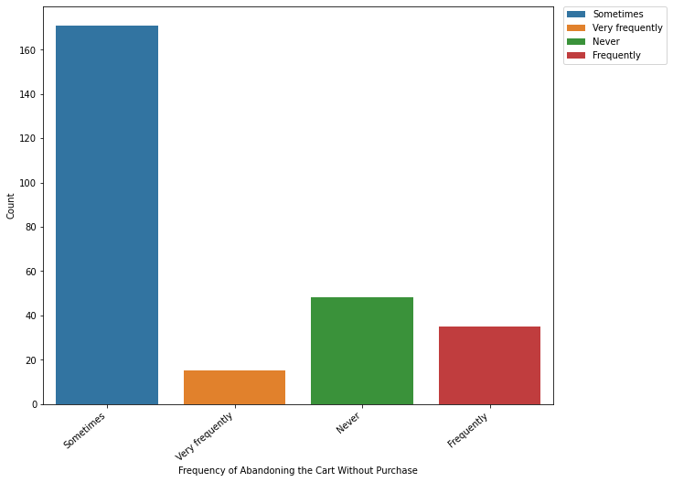
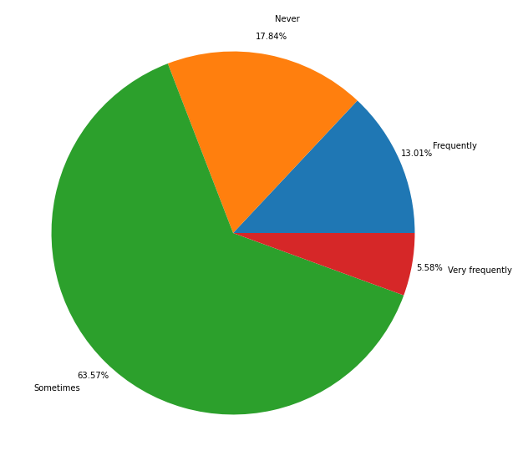
Analysis of data based on frequency of abandoning the cart without purchase
Findings:
1. Customers who abandon the cart sometimes while shopping online is 171 which includes 63.57% of the total customers.
2. Customers who abandon the cart very frequently are least among all customers, which is 15.(5.58% of the total customers).
3. The number of customers who never abandon the cart while shopping online is 48, which occupies 17.84% of the total customers. The number of customers who frequently abandon the cart is 35 which consists of 13.01% of the total customers.

Slide 25
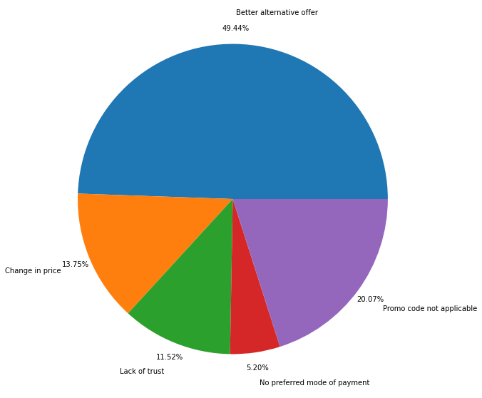
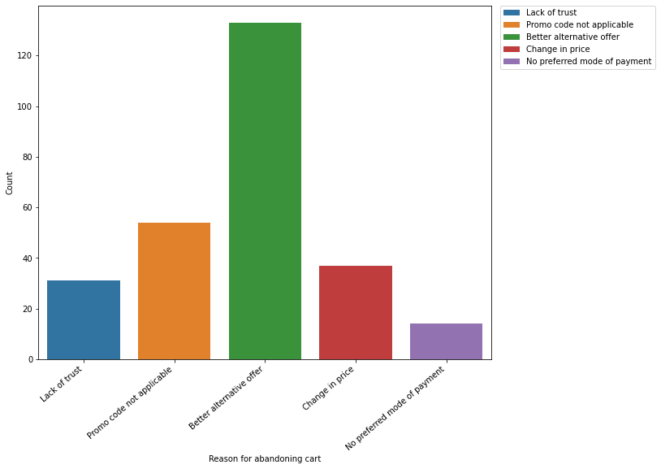
Analysis of data based on reason for abandoning cart
Findings:
1. Most number of customers are abandoning the cart because they found a better alternative offer(133). Only few customers are abandoning the cart because of unavailability of preferred payment mode(14).
2. The number of customers abandoning cart because of promo code not applicable is 54 and number of customers abandoning cart because of change in price is 37, but there are customers who abandon the cart because of lack of trust(31).

Slide 26
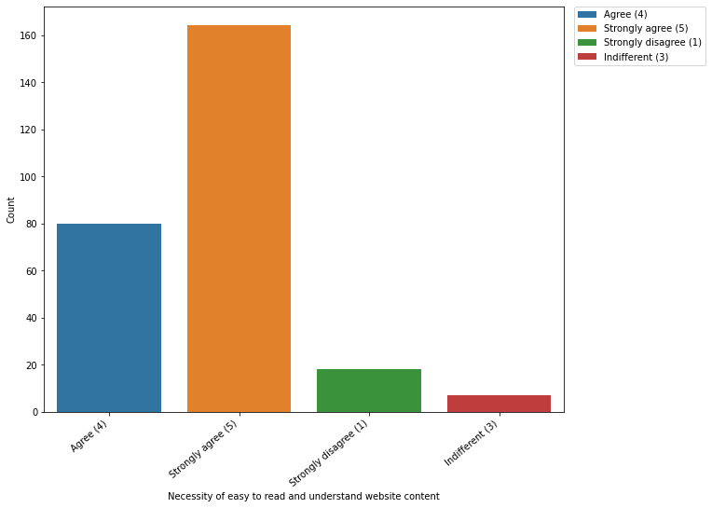
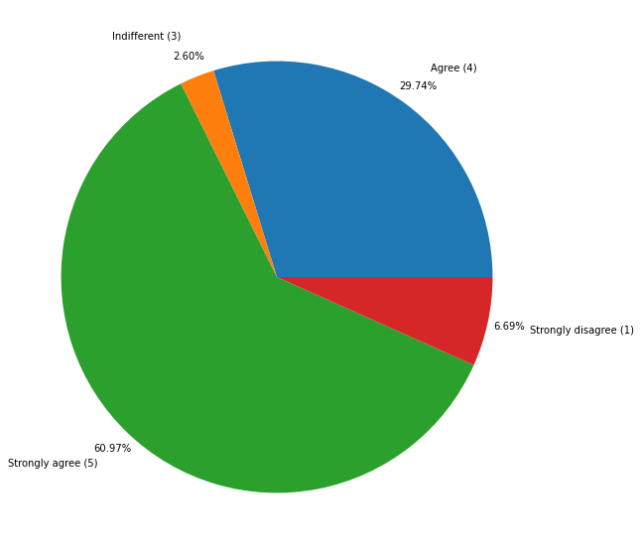
Analysis of data based on necessity of easy to read and understand website content
Findings:
Most number of customers prefer easy to read and understand the website content(164). Least number of customers are having indifferent opinion about the ease to read and understand the website content.

Slide 27
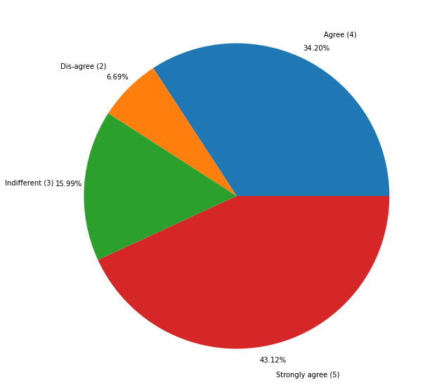
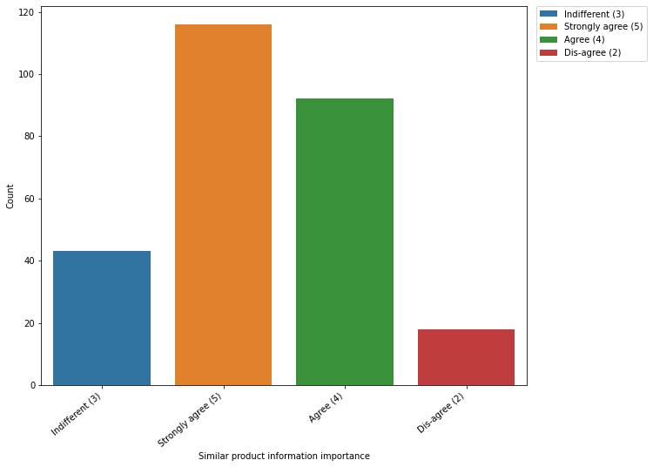
Analysis of data based on similar product information importance
Findings:
Most of the customers prefer to see similar product information on the website(116) while 18 customers didn't prefer to see similar product information on the website.

Slide 28
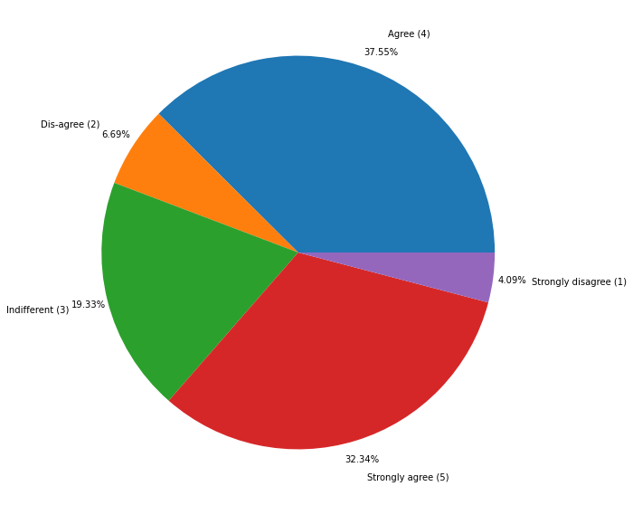
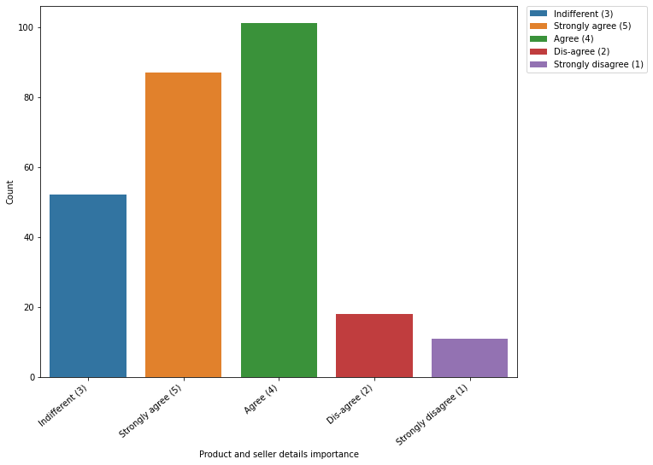
Analysis of data based on product and seller details importance
Findings:
1. The customers who are strongly agreeing to see product and seller details on website is 87. The number of customers who are agreeing( which is the most among the group) to see product and seller details on the website is 101.
2. 29(Dis-agree - 18, Strongly disagree - 11) customers prefer not to see product and seller information on the website.

Slide 29
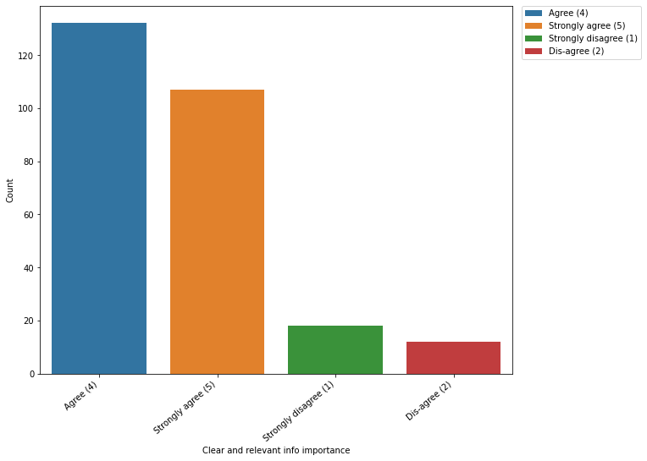
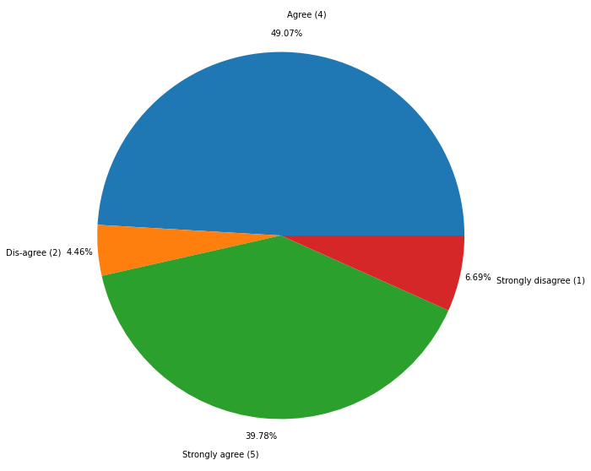
Analysis of data based on clear and relevant info importance
Findings:
1. The number of customers who find it important to show clear and relevant info on the website is 239(Agree - 132, Strongly Agree - 107). This would easily help them to make purchase decision.
2. The number of customers who don't find it relevant to show clear and relevant info on the shopping website is 30(Strongly Disagree - 18, Disagree - 12).

Slide 30
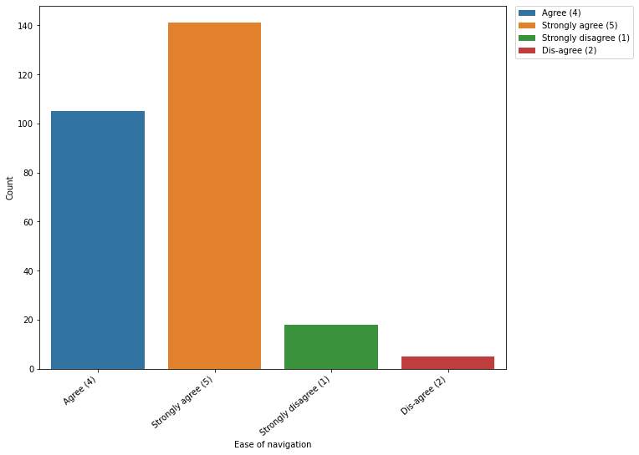
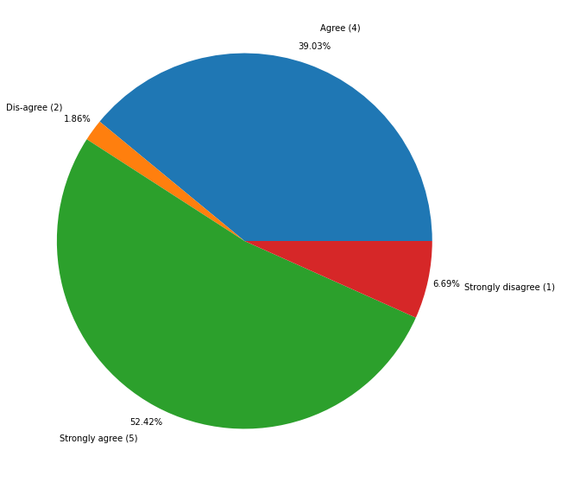
Analysis of data based on ease of navigation
Findings:
1. The number of customers who prefer easy navigations on website is 246(Strongly Agree - 141, Agree - 105). This consists of around 91.43% of the total customers.
2. The number of customers who don't prefer easy navigations on website is 23(Strongly Disagree - 18, Disagree - 5).

Slide 31
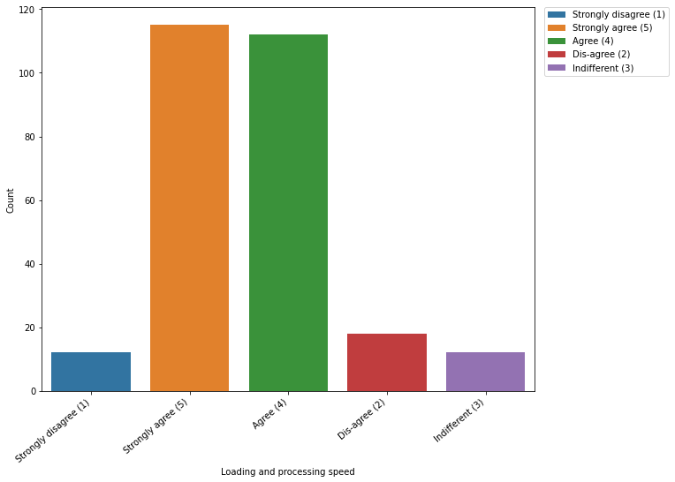
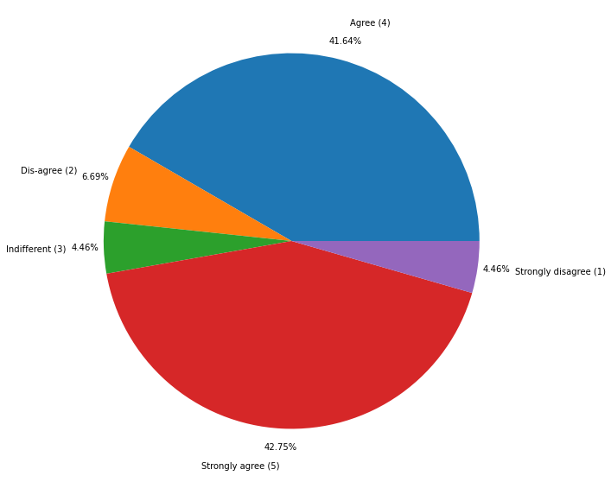
Analysis of data based on loading and processing speed
Findings:
1. Most of the customers prefer fast loading and processing of the webpage contents(Strongly Agree - 115,Agree - 112).
2. The number of customers who don't find it important about the loading and processing speed of the webpage content is 30(Strongly disagree - 12, Disagree - 18). 18 Customers are having indifferent opinion on loading and processing of the webpage content.

Slide 32
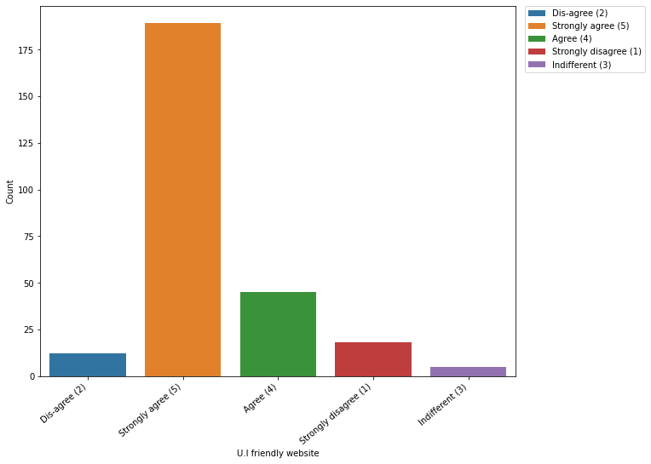
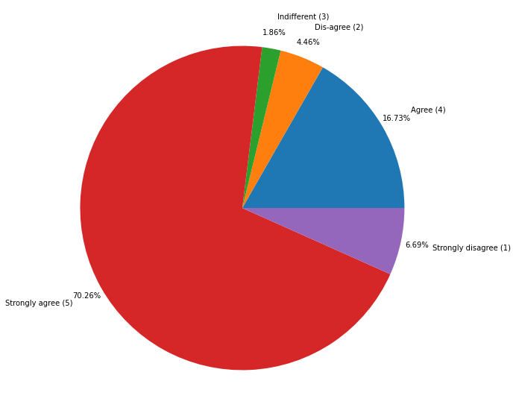
Analysis of data based on U.I friendly website
Findings:
1. Most of the customers prefer user friendly website for online shopping(Strongly Agree - 189,Agree - 45). Only 11.15% of the customers don't give much importance to the website being user-friendly(Disagree - 12, Strongly disagree - 18).
2. 5 customers are having indifferent opinion regarding the website being user-friendly cause it may differ according to various factors like, purpose, stage of purchase, website type etc.

Slide 33
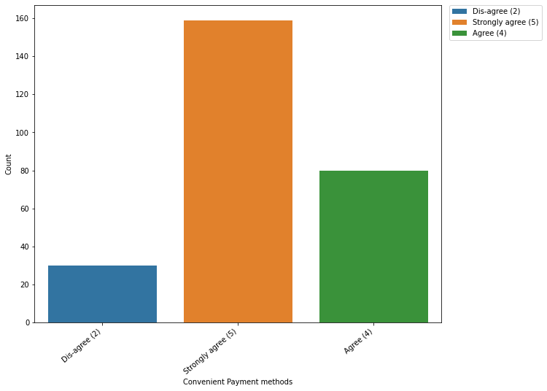

Analysis of data based on convenient payment methods
Findings:
1. 88.85% of the total customers prefer convenient payment method for shopping online from a website(Strongly Agree - 159, Agree - 80).
2. Only 11.15% of the population don't have preference for convenient payment method(Dis-agree - 30).

Slide 34


Analysis of data based on trust on ontime fulfillment
Findings:
1. Most of the customers like to have on time fulfillment for online shopping which consists of 84.39% of the total customers (Strongly Agree - 141, Agree - 86.
2. 11.15% of the customers don't give much importance to on time fulfillment(Disagree - 30).
3. 4.46% of the customers are having indifferent opinion on time fulfillment for online shopping.

Slide 35


Analysis of data based on empathy or readiness to assist
Findings:
1. Customers who prefer online stores on their empathy or readiness to assist consists of 87.73% of total customers(Strongly Agree - 194, Agree - 42).
2. Only 6.69% of the customers don't give much importance to the assisting mentality of the service or support team of online store(Strongly Disagree - 18). 15 customers are having indifferent opinions since it may differ according to their purpose of shopping, things they shop online etc.

Slide 36


Analysis of data based on privacy guarantee
Findings:
1. 90.33% of the customers prefer guaranteed privacy on online shopping websites.(Strongly Agree - 185, Agree - 58).
2. Only 9.67% of the customers are having indifference opinion on privacy guarantee provided by the online stores.

Slide 37


Analysis of data based on availability of several communication channels
Findings:
1. Most of the customers prefer multiple communication channel for an online store which consists of 90.33% of total customers(Strongly Agree - 149, Agree - 94).
2. Only 4.09% of the customers don't give much importance to the availability of multiple channels of communication for an online store(Strongly Disagree - 11). The number of customers having indifferent opinion about the availability of multiple channels of communication is 15.

Slide 38


Analysis of data based on having monetary benefits and discounts
Findings:
1. 70.63% of the customers like to have monetary benefits and discounts when then shop online from an online store(Strongly Agree - 105, Agree - 85).
2. 10.78% of the customers don't give much importance to the monetary benefits and discounts provided by the online stores while shopping online.(Strongly Disagree - 18, Disagree - 11). 50 Customers are having indifferent opinion on online stores providing monetary benefits and discounts during online shopping.

Slide 39


Analysis of data based on enjoyment in shopping online
Findings:
1. 86 customers are strongly agreeing to online stores should give much importance to enjoyment of a customer during online shopping. 59 Customers are just agreeing to this opinion.
2. 75 customers are having indifferent opinion about the importance of enjoyment in online shopping from an online store.
3. 18.21% of the customers are not giving much importance to the enjoyment during online shopping(Strongly Disagree - 30, Disagree - 19).

Slide 40


Analysis of data based on convenient and flexible
Findings:
1. 83.28% of the customers consider online shopping is convenient and flexible(Strongly Agree - 146,Agree - 78).
2. Only 4.46% of the customers is not agreeing to the opinion of online shpping is convenient and flexible(Disagree - 12). 12.27% of customers are having indifferent opinion(33 customers).

Slide 41


Analysis of data based on return replacement policy importance
Findings:
1. 92.57% of customers give much importance to return and replacement policy of an online store(Strongly Agree - 198, Agree - 51). Because the products are not analyzed by the physical appearances and quality and products may not be the same as on images when they arrive.
2. 7.43% of the customers are not giving much importance to return and replacement policy of an online store while shopping online.(Disagree - 20).

Slide 42


Analysis of data based on access to loyalty programs
Findings:
1. 66.54% of the customers would like to have access to loyalty programs when they shop from an online store.( Strongly Agree - 115, Agree - 64).
2. 9.67% of the customers don't give much importance to having access to loyalty programs when they shop from an online store.(Strongly Disagree - 11, Disagree - 15). 64 customers having indifferent opinion on having access to loyalty programs on online shopping.

Slide 43


Analysis of data based on displaying quality info on website satisfaction
Findings:
1. 79.18% of customers are being satisfied if quality information is provided on the website(Strongly Agree - 133, Agree - 80).
2. 20.82% of customers are having indifferent opinion on satisfaction on the quality information provided on the website for online shopping(56 customers).

Slide 44


Analysis of data based on good quality website or application satisfaction
Findings:
1. 97.03% of customers are satisfied if the online store is having quality website or application(Strongly Agree - 175, Agree - 86).
2. Only 8 customers are not much satisfied if the online store has quality website or application.

Slide 45


Analysis of data based on net benefit from shopping satisfaction
Findings:
1. 81.04% of the customers are being satisfied from the net benefits they are getting from the online shopping(Strongly Agree - 164, Agree - 54).
2. Only 4.09% of the customers are disagreeing with the opinion on satisfaction based on the net benefits from online shopping(11 customers). 14.87% of the customers are having indifferent opinion on being satisfied from the net benefits on online shopping(40 Customers).

Slide 46


Analysis of data based on user satisfaction cannot exist without trust
Findings:
1. 88.84% of the customers believe that user satisfaction cannot exist without trust during online shopping. (Strongly Agree - 122, Agree - 117).
2. 9.29% of customers are not agreeing to the opinion, 'user satisfaction cannot exist without trust'.(Strongly Disagree - 18, Disagree - 7).
3. 5 Customers are having indifferent opinion on user satisfaction cannot exist without trust.

Slide 47


Analysis of data based on availability of variety products in several categories
Findings:
1. Most of the customers prefer availability of variety products in several categories(Strongly Agree - 111, Agree - 94).
2. 7 customers disagreeing with the availability of variety products in several categories on online stores.

Slide 48


Analysis of data based on provision of complete and relevant product information
Findings:
1. 86.62% of customers would like to have provisions to access complete and relevant information of product on online store websites/applications.(Strongly Agree - 135, Agree - 98).
2. 5 customers don't give much importance to online stores having provisions to complete and relevant information on products on their website/applications. 11.52% of customers are having indifference opinion on online stores having provisions to complete and relevant information on products on their websites/applications.

Slide 49


Analysis of data based on monetary savings
Findings:
1. 82.9% of customers preferring online stores for monetary benefits(Strongly Agree - 148, Agree - 75).
2. 31 Customers(11.52%) are disagreeing to the opinion on preferring online stores for monetary benefits. 5.58% of customers are having indifferent opinion.

Slide 50


Analysis of data based on the convenience of patronizing the online retailer
Findings:
51.30% of customers are agreeing to convenience on patronizing online retailer and 20.07% of customers strongly agreeing to this opinion. But 28.62% of customers are having indifferent opinion on convenience on patronizing online retailers.

Slide 51


Analysis of data based on sense of adventure during shopping
Findings:
1. 57.62% of customers would like to have a sense of adventure during online shopping(Strongly Agree - 54, Agree - 101).
2. But 20.45% of customers disagree with the opinion of having a sense of adventure during online shopping.( Strongly Disagree - 5, Disagree - 50).
3. 21.93% of customers are having indifference for the opinion of having sense of adventure during online shopping.

Slide 52


Analysis of data based on enhancing social status on preferred e-tailer shopping
Findings:
1. 39.77% of customers are having the belief that their social status is enhanced when they shop from the preferred e-tailer.(Strongly Agree - 48, Agree - 59. While 100 customers are having indifference to this opinion.
2. 23.05% of customers are not agreeing to the opinion that shopping online from preferred e-tailer would enhance the social status(Disagree - 29, Strongly Disagree - 33).

Slide 53


Analysis of data based on gratification on shopping through favorite e-tailer
Findings:
1. 101 customers are having indifference on opinion that online shopping from favorite e-tailer would enhance gratification. But 47.58% of the customers believe this opinion is true that they would feel gratification when they shop online from favorite e-tailer(Strongly Agree - 65, Agree - 63).
2. 14.87% of customers are not agreeing to this opinion( Disagree - 22, Strongly Disagree - 18).

Slide 54


Analysis of data based on fulfill certain roles during shopping on website
Findings:
1. 46.84% of customers believe that they can fulfill certain roles when they shop online(Strongly Agree - 38, Agree - 88). While 88 customers are having indifference to this opinion.
2. 20.45% of customers are not agreeing to the opinion that online shopping would fulfill certain roles.

Slide 55


Analysis of data based on getting value for money spent
Findings:
1. 85.87% of customers believe they are getting value for money spent on online shopping. (Strongly Agree - 82, Agree - 149).
2. 14.13% of customers are having indifference to this opinion(38 customers).

Slide 56


Analysis of data based on online retailers you have shopped from
Findings:
Most of the customers have shopped from major online e-tailers(Amazon.in, Flipkart.com, Paytm.com, Myntra.com, Snapdeal.com)

Slide 57


Analysis of data based on easy-to-use website or application
Findings:
Most of the users believe that Flipkart.com and Amazon.in are having easy to use website and application for online shopping.

Slide 58


Analysis of data based on visual appealing web-page layout
Findings:
Most of the customers says Amazon.in and Flipkart.com are having visually appealing web-page layout.

Slide 59


Analysis of data based on wild variety of product on offer
Findings:
Most of the customers are having the opinion that Amazon.in and Flipkart.com are having the variety of categories for products which are available on offers.

Slide 60


Analysis of data based on complete, relevant description information of products
Findings:
Most of the users says Amazon.in provides complete and relevant information on products. Second most e-tailer is Flipkart.com.

Slide 61


Analysis of data based on fast loading website speed of website and application
Findings:
Most of the users have rated Amazon.in is having fastest loading speed on website and application. Second highest e-tailer with fast loading speed for website and application is Paytm.com

Slide 62


Analysis of data based on reliability of the website or application
Findings:
Most of the customers says Amazon.in is having a reliable website and application. Second most rated e-tailer is Flipkart.com

Slide 63


Analysis of data based on quickness to complete purchase
Findings:
Most customers have rated Amazon.com is the online store where they can quickly complete the purchase.

Slide 64


Analysis of data based on availability of several payment options
Findings:
Most of the customers are having the opinion Amazon.in and Flipkart.com are having several payment methods

Slide 65


Analysis of data based on speedy order delivery
Findings:
Most of the customers have rated Amazon.in as the e-tailer with speedy order delivery compared to other e-tailers. Second most rated e-tailer for speedy deliver of orders is Flipkart.com

Slide 66


Analysis of data based on privacy of customers’ information
Findings:
Most of the customers believe that Amazon.in is the e-tailer that provides maximum privacy on customer information.

Slide 67


Analysis of data based on security of customer financial information
Findings:
Most of the customers have rated Amazon.in and Flipkart for having highest security for customers' financial information.

Slide 68


Analysis of data based on perceived trustworthiness
Findings:
Most of the customers have rated Amazon.in as most trustable e-tailers compared to all other e-tailers.

Slide 69


Analysis of data based on presence of online assistance through multi-channel
Findings:
Most of the customers says Amazon.in is having multiple channels for online assistance.

Slide 70


Analysis of data based on longer time to get logged in (promotion, sales period)
Findings:
Most of the customers have rated Amazon.in would take much more time to log in during promotion and sales period. Second most rated e-tailer is Paytm.com

Slide 71


Analysis of data based on longer time in displaying graphics and photos (promotion, sales period)
Findings:
Most of the customer says Amaon.in takes more time to display images and graphical contents during promotion and sales period.

Slide 72


Analysis of data based on late declaration of price (promotion, sales period)
Findings:
Most of the customers have rated Paytm.com as the e-tailer whose website or application take longer page loading time during promotion or sale period.

Slide 73


Analysis of data based on longer page loading time (promotion, sales period)
Findings:
Most of the customers have rated Paytm.com as the e-tailer whose website or application take longer page loading time during promotion or sale period.

Slide 74


Analysis of data based on limited mode of payment on most products (promotion, sales period)
Findings:
Most of the customers have rated Snapdeal.com and Amazon.in are having limited payment modes on most products during promotion and sale period.

Slide 75


Analysis of data based on longer delivery period
Findings:
Most of the customers have rated Snapdeal.com and Paytm.com as the e-tailers that takes longer deliver time of orders.

Slide 76


Analysis of data based on change in website/application design
Findings:
Most of the customers have rated Amazon.in as the e-tailer whose website/application having changes in designs.

Slide 77


Analysis of data based on frequent disruption when moving from one page to another
Findings:
Most of the customers have rated Amazon.in and Myntra.com are having frequent disruptions when moving from one page to another.

Slide 78


Analysis of data based on website is as efficient as before
Findings:
Most of the customers have rated Amazon.in as the e-tailer having website which is efficient as before.

Slide 79


Analysis of data based on recommended best online retailer
Findings:
Most of the customers have rated Amazon.in as the best recommended online retailer. Second most rated e-tailer is Flipkart.com

Slide 80

Statistical Summary of Data(Describe of Data)
Findings:
Most of the categorical columns are having higher mean value than the median value. But since the data is categorical in nature but were encoded, skewness is irrelevant for these data.

Slide 81

Correlation

Slide 82
Findings
From the above observations, customers were asked to rate the best e-tailer(Amazon.in, Flipkart.com, Paytm.com, Myntra.com, Snapdeal.com) according to various aspects. Out of which Amazon.in was rated as best e-tailers compared to other e-tailers during various aspects. Also, there were user ratings where Amazon.in was having the drawbacks (like longer time to load graphical and image contents during sale or promotion period). But after considering all the customer ratings, Amazon.in was customers' choice for an ideal e-tailer compared to other e-tailers.

Slide 83
Conclusion
When it comes to customer retention on online shopping, e-tailers should consider the hedonic values and utilitarian values to increase the customer base and attract more customers to online shopping. Five major factors that contributed to the success of an e-commerce store have been identified as: service quality, system quality, information quality, trust and net benefit. The research furthermore investigated the factors that influence the online customers repeat purchase intention.
Currently most of the e-tailers are working well by providing better quality products with better services at affordable prices and improving their pre-sale and after-sale services. When it comes to online shopping, e-tailers should also consider other factors like on time delivery, multichannel communication service, multiple payment modes, readiness to assist the customers with the best support team, providing promotions, sale, access to loyalty program etc. to improve the repeat purchase and to bring more potential customers.

Slide 84
Thank you

